Slide 1

Cloud-based database
Postgresql & aws rds

Slide 2
Table of contents
Introduction
PostgreSQL asynchronous streaming master-slave replication
Amazon RDS
Amazon Aurora
Conclusion
References

Slide 3
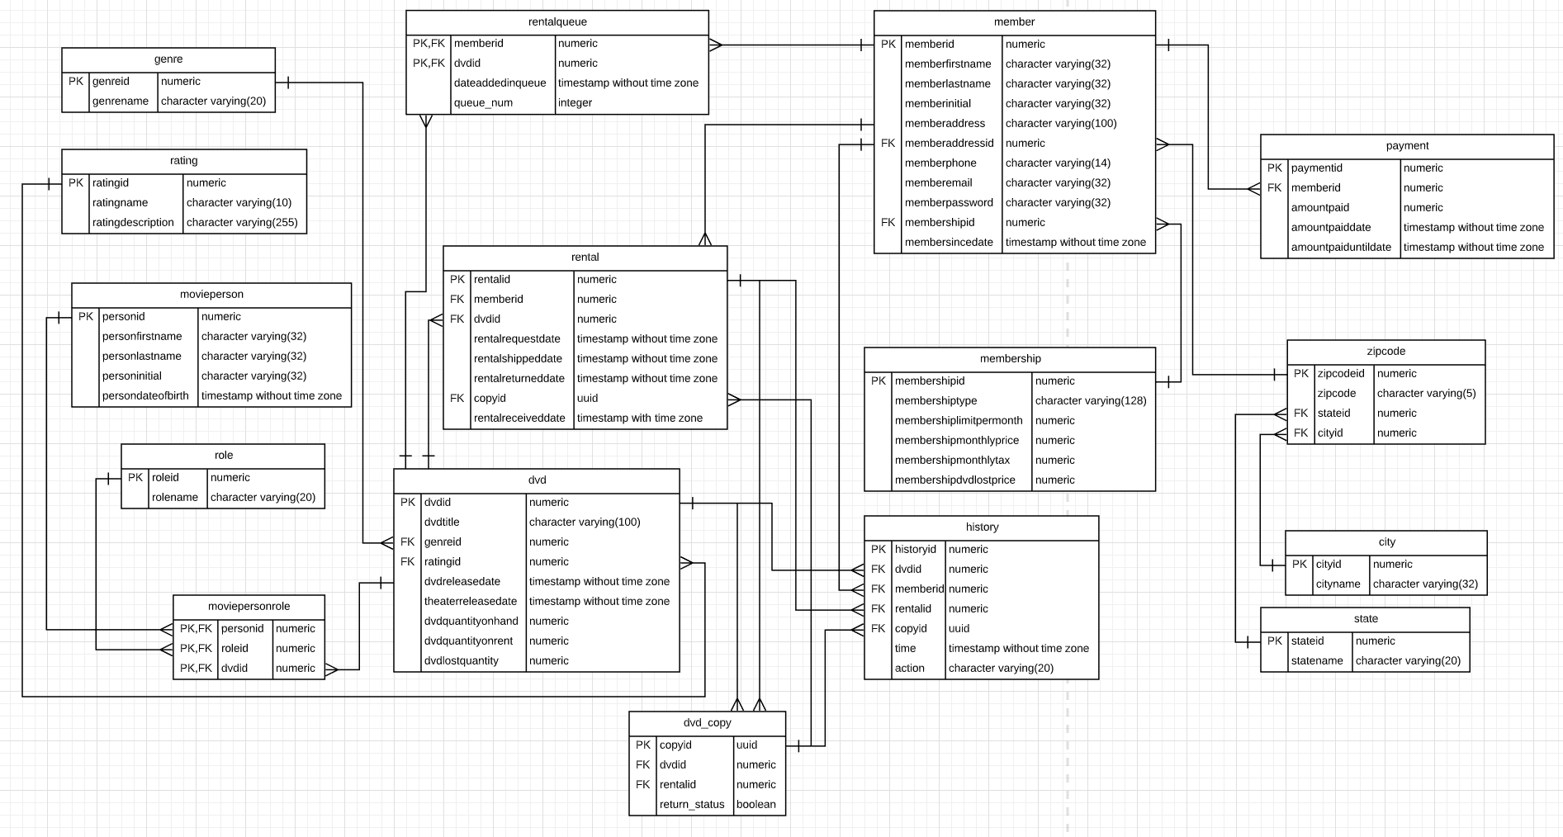
Introduction

Slide 4
Introduction
Netflix database
The business has developed and grown very fast
To be close to end users and to improve disaster tolerance
One-write and multiple-reads
Notes:
Assuming the business has developed and grown very fast in the past few years. As the example of Netflix database ERD (Figure 1.1) had shown, the amount of data and business became more and more complex and diverse. In order to be close to end users and to improve disaster tolerance, the company may deploy databases worldwide such as China, the United States, and Europe. And keep the data consistent which can make one-write and multiple-reads. The cloud-based database will eventually become necessary. Because of this consideration, I will conduct research on the features of cloud-based database about PostgreSQL and AWS RDS service based on the Netflix database provided in this semester. The main topic would be to focus on its concept of replication.

Slide 5
PostgreSQL asynchronous streaming replication
System: CentOS release 6.6.
PostgreSQL 9.6.6.
SELinux = disabled
Iptables closed
The master database IP: 192.168.221.161
The slave database IP: 192.168.221.160
Notes:
First of all, the replication is one of the most important and attractive features for cloud-based database. Manual implementation of the replication of the database was complex to implement in the past before those famous network company did not launch their cloud services yet.
PostgreSQL has launched a log shipping similar to Oracle's active dataguard and MySQL relay log after version 9.0. With this feature, we can achieve master-slave replication of PostgreSQL. The basic principle was that one master database provides read and write usually, and then synchronizes the data to another slave database. The slave library continuously applies the data received from the master library. The slave library does not provide write services, but only provides external read services. The server that provides full read and write functions in PostgreSQL is called primary database or master database, and the slave database server that can provide read services while receiving synchronization data from the primary database is called hot standby server.
PostgreSQL maintains a WAL log file in the pg_xlog subdirectory of the data directory. This file is used to record each change of the database file. This log file mechanism provides a database hot backup scheme, that is, when the database is used When the file system is backed up, the corresponding WAL log is also backed up. Even if the data blocks backed up are inconsistent, the WAL log can be replayed to push the backup content to a consistent state. This is also known as Point-in-Time Recovery, or PITR for short. There are two ways to transfer WAL logs to another server, which:
WAL log archive (base-file) WAL日志归档（base-file）
Streaming replication (PostgreSQL, 2020) 流复制（streaming replication）
The first type was to copy the WAL log file to the standby database after writing a WAL log. In short, the remote backup is realized through the cp command, so that the standby database usually lags behind the main database by one WAL log file. The second type which called streaming replication was a new method of transferring WAL logs provided after PostgreSQL 9.x. Its advantage is that as soon as the master library generates a log, it will be immediately transferred to the standby library, which is lower than the first synchronization delay, so we will definitely choose streaming replication.
Before the actual operation, there is one more point that needs to be explained is the most critical step in the establishment of the standby-the basic backup of the master is generated in the standby. After postgresql9.1, a very convenient tool-pg_basebackup is provided. The detailed introduction and parameter description can be viewed on the official website (Documentation, 2020).
Based on the cost and necessary requirements, I chose to use free trial of virtual machine from Alibaba Cloud (Alibaba Cloud, 2020). There is the environment of the rental virtual machine for the example testing:
Security-Enhanced Linux (SELinux) is a Linux kernel security module that provides a mechanism for supporting access control security policies, including mandatory access controls (MAC).
SELinux is a set of kernel modifications and user-space tools that have been added to various Linux distributions. Its architecture strives to separate enforcement of security decisions from the security policy, and streamlines the amount of software involved with security policy enforcement.^{[3][4]} The key concepts underlying SELinux can be traced to several earlier projects by the United States National Security Agency (NSA).
iptables is a user-space utility program that allows a system administrator to configure the IP packet filter rules of the Linux kernel firewall, implemented as different Netfilter modules. The filters are organized in different tables, which contain chains of rules for how to treat network traffic packets. Different kernel modules and programs are currently used for different protocols; iptables applies to IPv4, ip6tables to IPv6, arptables to ARP, and ebtables to Ethernet frames.

Slide 6
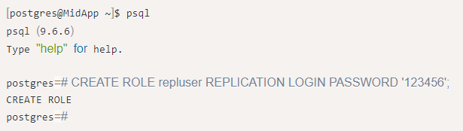
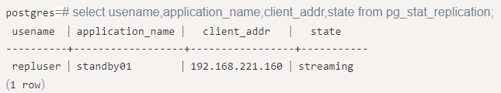
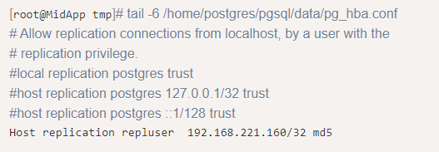
Master database
Notes:
Add a synchronized username and password in the main database:
在主库通过select usename,application_name,client_addr,state from pg_stat_replication查询一下：可以看到192.168.221.160上的repluser在通过流复制的方式同步主库的数据
Modify “/home/postgres/pgsql/data/pg_hba.conf” and add the last line: Notice that this line of configuration means that the user repluser is allowed to initiate a streaming replication connection to this database in the form of md5 encryption from the host 192.168.221.160.

Slide 7
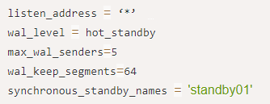

Master database
Notes:
Configure the following parameters in the main configuration file: The first parameter indicates to monitor all IP; the second parameter indicates to start hot standby; the third parameter indicates how many concurrent standby databases the main database can have, here is set to 5; the fourth parameter indicates the size of a WAL log file, The default is 16MB; the fifth parameter specifies the name of the standby for synchronous replication.
Restart the main library for the configuration to take effect. If an error is reported during startup, you can go to the log for troubleshooting.

Slide 8
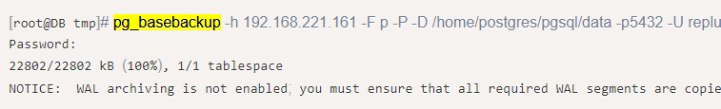
slave database
Notes:
First of all, it is necessary to ensure that the environment before the synchronization between the main library and the slave library is consistent, so as to facilitate synchronization.
首先要保证主库、从库之间的同步之前的环境的是一致的，这样才方便做同步。我因为之前就在从库机器上配置过PG数据库，所以一开始走了不少弯路。最后把PG的家目录清空，重新再来一次才算成功。
Use the pg_basebackup command line tool to generate a basic backup on the slave library. The command is as follows. If you see 100%, the backup is successful:
参数说明：-h 指定连接的数据库IP；
-F 指定输出的格式，支持p(plain原样输出)或者t(tar格式输出)
-P 在备份过程中实时打印备份进度
-D 指定备份的目录
-U 指定连接的用户名
-p 指定要连接的端口
--password 指定要连接的用户密码
其他参数介绍：
-R 会在备份后自动生成recovery.conf文件，我也是事后才知道这个参数
-l 指定一个备份的标识
具体的参数介绍可以使用pg_basebackup --help查看，也可以查看官网介绍
手动拷贝 recovery.conf 添加以下信息：
standby_mode = on
primary_conninfo = 'application_name=standby01 user=repluser password=123456 host=192.168.221.161 port=5432 sslmode=disable sslcompression=1’
修改从库的主配置文件/home/postgres/pgsql/data/postgresql.conf: hot_standby = on

Slide 9


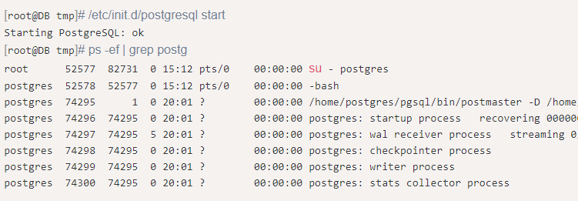
slave database
Notes:
Now the slave database can be started: The error exception showed “Permission denied” at first time because the command to generate the backup above was executed by the root user, causing the attribute of the PG home directory to become root. Therefore, the permissions need to be reset. 第一次启动报错，这是因为上面生成备份的命令我使用root用户执行的，导致PG家目录的属性变成了root，所以要重新设置权限(Authority)
再次启动正常，查看进程也OK

Slide 10
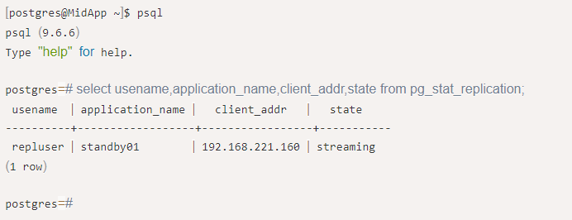
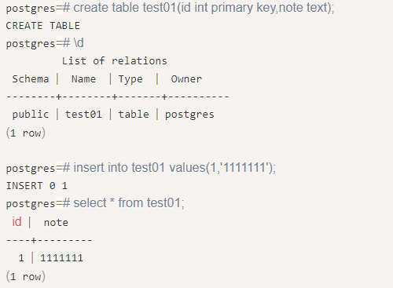
Test results
Notes:
1. 在主库通过select usename,application_name,client_addr,state from pg_stat_replication查询一下：可以看到192.168.221.160上的repluser在通过流复制的方式同步主库的数据
2. 创建表验证一下, 主库上建表，并插入数据验证

Slide 11
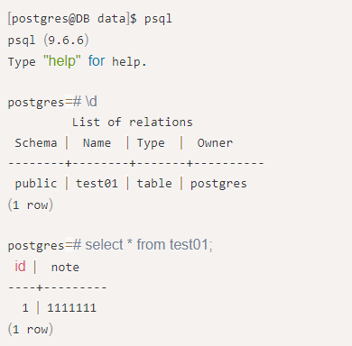

Test results
Notes:
3. 在从库上查看：
4. 尝试插入数据看一下：可以看到，从库可以查看从主库同步过来的数据，但并不能写数据。

Slide 12
Aws rds for postgresql
Complex and difficult deployment task to manually set up replication
Operations and maintenance tasks that follow
Notes:
Although to manually develop and deploy the replication feature of the business databases was possible, as people knew, this used to be a complex and difficult deployment task; in addition to this, there was also operations and maintenance tasks that follow. Hosting services such as AWS RDS has cross region read replica can be greatly used in this situation. Thus, the experience of AWS RDS from mine will be shown below.

Slide 13
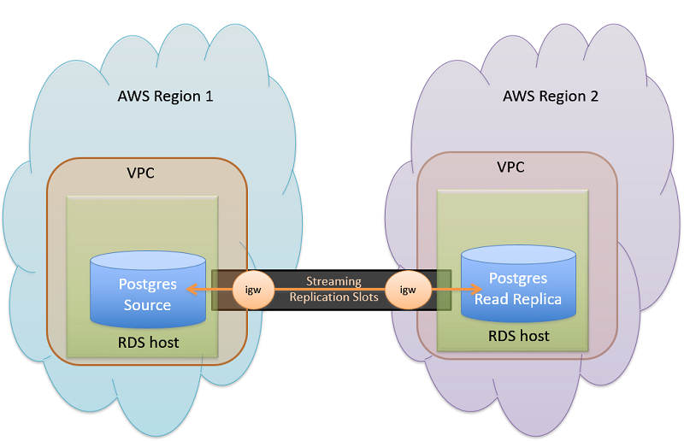
Aws rds for postgresql
Notes:
Moreover, creating a read replica in a different AWS region by using cross region read replica can effectively improve the data reading speed and disperse the pressure of a single database. Also, this would make it easier to migrate from a data center in one AWS Region to a data center in another AWS Region. The following diagram illustrates how Amazon RDS for PostgreSQL performs replication between a source and replica in different Regions show at the article, Best practices for Amazon RDS for PostgreSQL cross-Region read replicas (Singh, 2020).

Slide 14
Aws Aurora
The amount of user’s input has gradually increased and become very dense
The network latency requirements of read-only nodes are kept as low as possible
Notes:
However, the amount of user’s input has gradually increased and become very dense; and the network latency requirements of read-only nodes are kept as low as possible. AWS RDS may no longer had the ability to handle this kind of problem. Thus, Amazon Aurora would be the better option in this situation.
Amazon Aurora was still a kind of relationship database which was fully compatible with MySQL and PostgreSQL. Amazon Aurora Global Database is designed for globally distributed applications, allowing multiple AWS regions to cover a single Amazon Aurora database.

Slide 15
Aws Aurora
Network latency of replication was lower than another
Relatively little impact on the input performance of the master database which in main region
Disaster preparedness in Amazon Aurora had been improved as much as possible
Notes:
However, the amount of user’s input has gradually increased and become very dense; and the network latency requirements of read-only nodes are kept as low as possible. AWS RDS may no longer had the ability to handle this kind of problem. Thus, Amazon Aurora would be the better option in this situation.
Amazon Aurora was still a kind of relationship database which was fully compatible with MySQL and PostgreSQL. Amazon Aurora Global Database is designed for globally distributed applications, allowing multiple AWS regions to cover a single Amazon Aurora database.

Slide 16
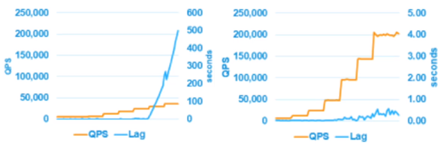
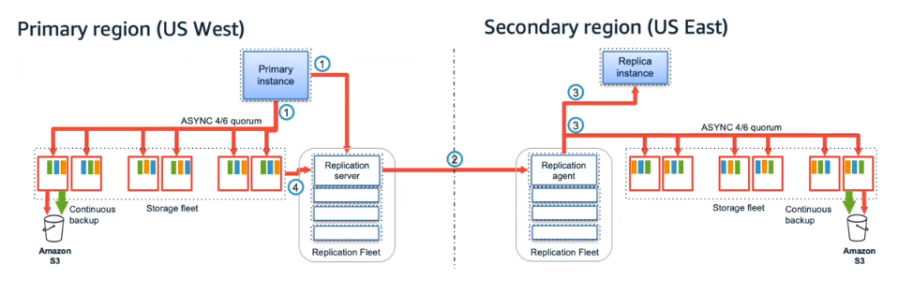
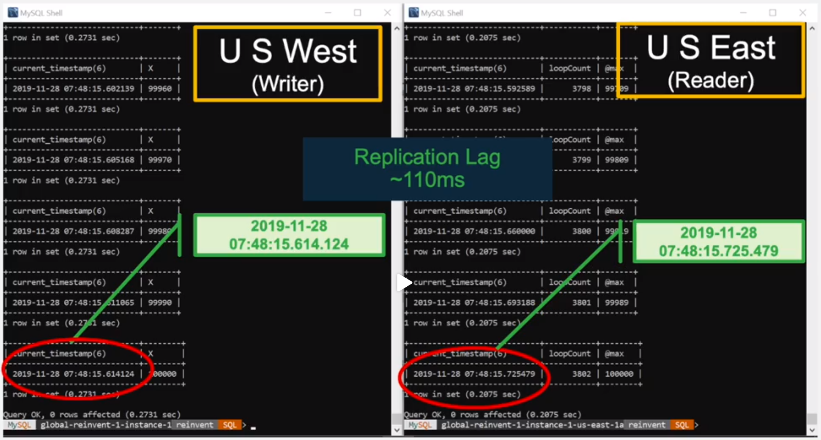
Aws Aurora
Notes:
There was the figure of comparison between logical replication (left) and physical replication (right). As people knew, the replicaiton based on Binglog which is kind of logical replication of AWS RDS for MySQL was closely related to the inpout load. When the business has a high frequency and a large number of inputs, the lag will inevitably increase. Sometimes, the lag may be very exaggerated such as tens of seconds or minutes, resulting in unavailability of business. However, Amazon Aurora's log-based physical replication method is very stable. Even when the business faces heavy input, it can still provide only sub-second lag.
Moreover, disaster preparedness in Amazon Aurora had been improved as much as possible. When something goes wrong, it only takes one minute to raise the auxiliary region. There was an example from Lin Lv (2020).
In the test, records are continuously inserted in the main region, and a timestamp is left every time it is inserted (Figure 2); then, the auxiliary region is continuously queried and a timestamp is also left. When this record is copied from the US West to the US East, the two timestamps can be compared; the delay is about 110 milliseconds (Figure 3).

Slide 17
Conclusion
Replication
Partitioning (shards)
Distributed database
Notes:
Replication is one of the amazing features of cloud-based database. It implemented data synchronization across machines and regions, and physically reduced the time and other costs of data interaction. AWS RDS is only one of the Cloud service suppliers in this big network market; other company such as Google, Microsoft, Alibaba, and other great ones were also providing their own cloud services. Furthermore, Partitioning is also a feature which included in the cloud-based database together with the replication, and also, they were parts of the distributed database. Distributed databases are a set of databases split across various locations that communicate and deliver services over a network. The benefits of it such as easily scale-out of the entire production and set up replication to maintain your data's integrity and high availability, simple failover. However, some cons such as hard to maintain and set up made me extremely hard to complete the works in a limited short period. This would be some regrets at this moment; I would like to try to implement this part in the next step of this project.

